Slide 1
Before taking
Notes:
Recommended preparation before introducing AchieveWorks Aptitudes to students includes:
Reading the AchieveWorks Aptitudes Counselor Handbook
Reading the AchieveWorks Aptitudes Implementation Guide
Taking the AchieveWorks Aptitudes assessment as a student

Slide 2
What is an aptitude?
An aptitude is a readiness to develop
and perform in a particular area
Your aptitudes are shaped by
both genetics and practice
Notes:
See page 1 of AchieveWorks Aptitudes Counselor Handbook for more detail

Slide 3
Why aptitudes?
Identify your current aptitudes
Find opportunities to grow your aptitudes
Explore career and pathway matches
Notes:
See pages 1 and 7-9 of AchieveWorks Aptitudes Counselor Handbook for more detail

Slide 4
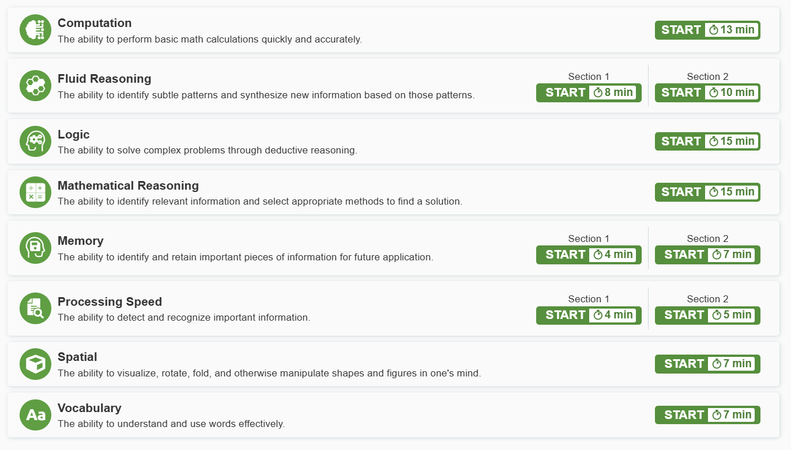
How does it work?
Recommended
Pencil & paper
8 aptitude assessments
Calculator okay
Bigger display
1-2 timed sections each
Notes:
See pages 4-6 and the FAQ section of AchieveWorks Aptitudes Counselor Handbook for more detail
Why are there so many different parts to the assessment?
The 11 individual assessment sections reflect the complex and multi-dimensional nature of cognitive abilities. By measuring each aspect independently, AchieveWorks Aptitudes provides a more detailed and accurate picture of a student's current strengths. This structure also supports more meaningful alignment with career pathways that suit a student’s aptitude profile. Additionally, the varied assessment formats offer greater accessibility for students with different learning needs, as some assessment types may be more suitable than others for particular individuals.
Why do some aptitudes have two parts?
Fluid Reasoning, Processing Speed, and Memory are each measured using two distinct sections—one in an image-based modality and one in a text-based modality.
The image-based modality involves direct interpretation of images or shapes—information that is processed visually and literally.
The text-based modality uses abstract symbols such as letters, numbers or words—systems of meaning that must be learned and interpreted.

Slide 5
About the assessments…
  You may be asked to…
    take them in a certain order
    skip one or more sections
1x
  Sections can only be taken once
  Questions gradually get more difficult
Notes:
See pages 4 and 10-12 of AchieveWorks Aptitudes Counselor Handbook for more detail
Do students need to complete all of the assessment sections?
Students are not required to complete all 11 sections at once, and in some cases, not all of them may be necessary. Completing the full set typically takes about two hours, so we recommend spreading this out over multiple sessions. Results are available for each aptitude as soon as all related sections for that aptitude are completed, offering valuable insights along the way. Completing the full set does allow for better matching to career opportunities.
What happens if a student exits an assessment section before finishing?
If a student exits an individual assessment section before completing it, the system will automatically lock that section. Any responses submitted up to that point will be scored, and a final result will be calculated based on the completed portion. The student will not be able to return to or resume the same section once it has been exited.

Slide 6
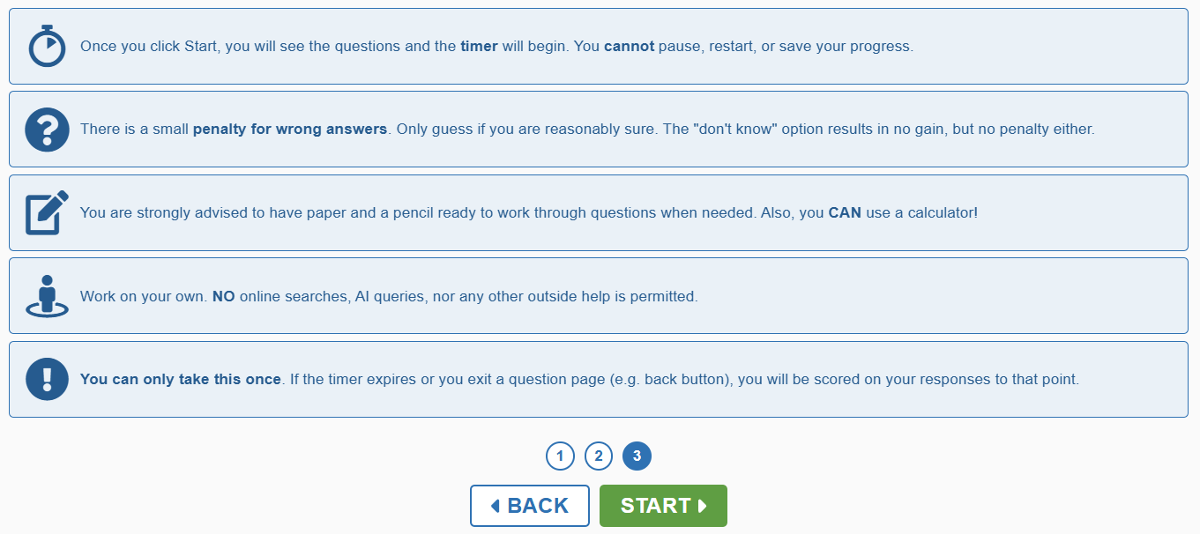

Make sure to carefully read the instructions!
The timer starts here
Notes:
See page 5 and the FAQ section of the AchieveWorks Aptitudes Counselor Handbook for more detail

Slide 7
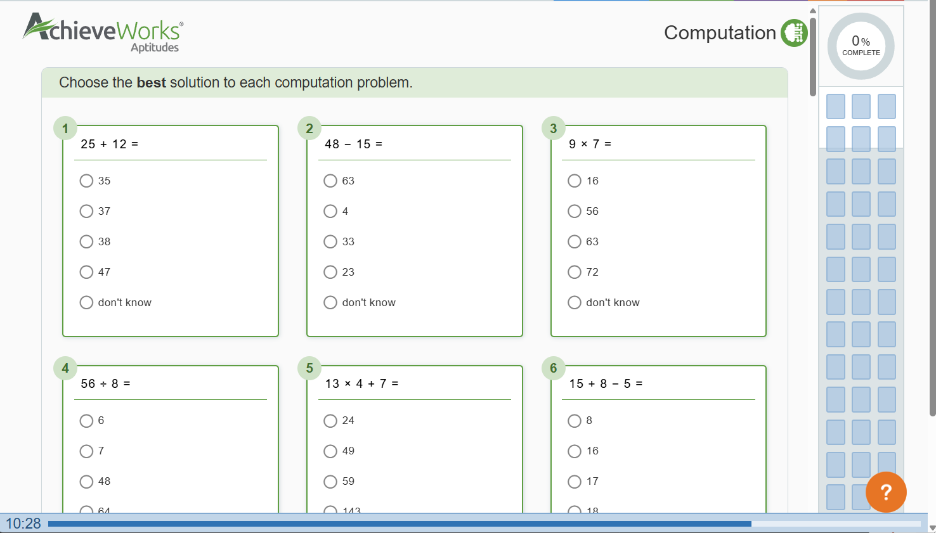
During the assessment
Question tracker
See what you have answered and quickly return to unanswered questions
Timer
Notes:
See page 6 of AchieveWorks Aptitudes Counselor Handbook for more detail

Slide 8
Don’t know the answer?
Each question has 5 possible responses
1 point for correct answers
–0.25 points for incorrect answers
0 points (no penalty) for both
“Don’t know” answers and unanswered questions
Work quickly and carefully – if you’re not sure, skip the question then try it later
Notes:
See page 13 of AchieveWorks Aptitudes Counselor Handbook for the FAQ below and others like it
What should a student do if they don’t know the answer to a question?
This is an important conversation to have before a student begins the assessment. Each question offers five response options: four content-based choices and a fifth option, “Don’t know.” This option is included to discourage random guessing and ensure results reflect what the student truly knows or can do.
The scoring system is designed to account for the chance of guessing. A correct answer earns +1.0 point, but an incorrect answer results in a deduction of -0.25 points. The reason for this penalty is statistical: with four content options, a random guess has a 25% chance of being correct, which could unfairly inflate scores over time.
If a student genuinely does not know the answer and cannot eliminate any options, they are encouraged to select “Don’t know,” which is scored as 0 points—no gain, but no penalty. However, if the student can confidently narrow the options down to two, it may be worth making an informed guess, as the odds of selecting the correct answer increase to 50%.
This approach rewards knowledge and thoughtful decision-making while discouraging pure guessing, helping to produce more accurate and meaningful results.

Slide 9
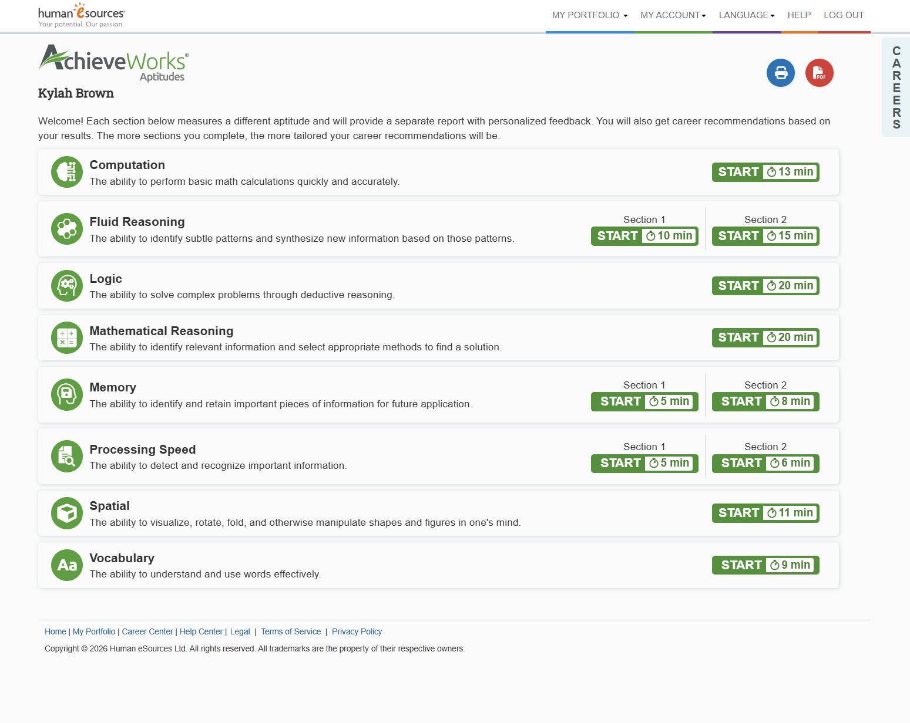
Notes:
See AchieveWorks Aptitudes Counselor Handbook for more details

Slide 10
You’ve got this!
When you do your best your score
will reflect your current abilities and career recommendations
Don’t compare yourself to others
or stress about your results
Notes:
See the FAQs on pages 10-11 of AchieveWorks Aptitudes Counselor Handbook for more detail
What is considered a “good” score?
There is no “good” or “bad” score when it comes to aptitudes—only a reflection of your current stage of development. Think of it like a snapshot of your height at a certain age: it simply shows where you are right now. The key difference is that, unlike height, aptitudes can continue to grow and improve with focused effort and practice.
What if a student doesn't achieve the results they expected?

Slide 11
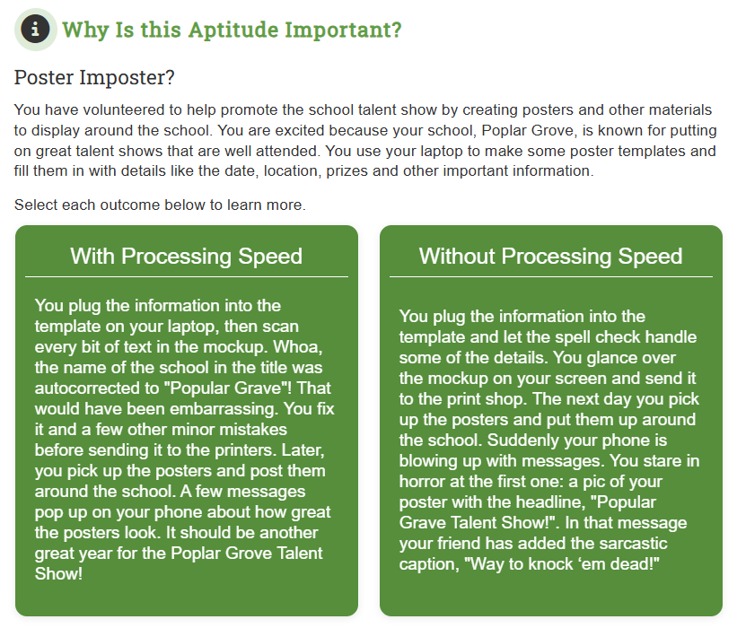
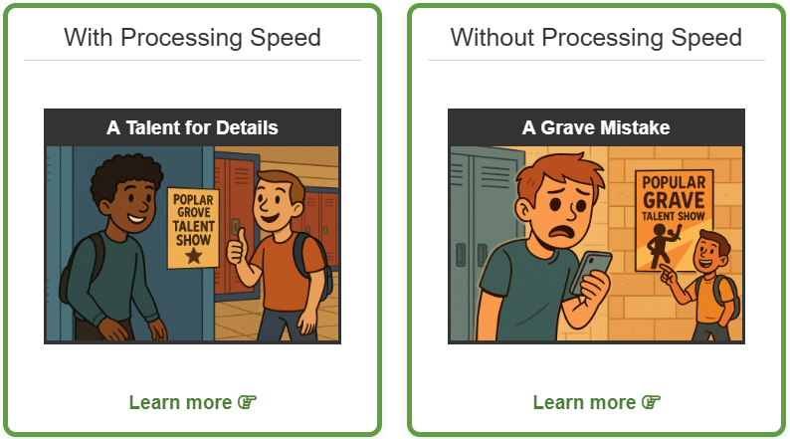
Each time you complete an aptitude…
you’ll be walked through each areas of your report
you’ll see your development stage (early, middle or advanced development)
you’ll learn why this aptitude is important and how we all use it
you’ll get an updated list of careers matched to you based on completed aptitudes
Notes:
See pages 7-9 of AchieveWorks Aptitudes Counselor Handbook for more detail on the reports

Slide 12
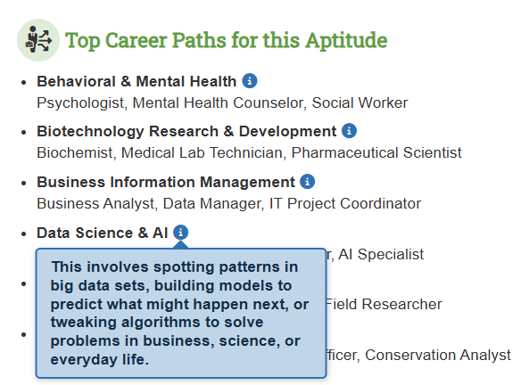
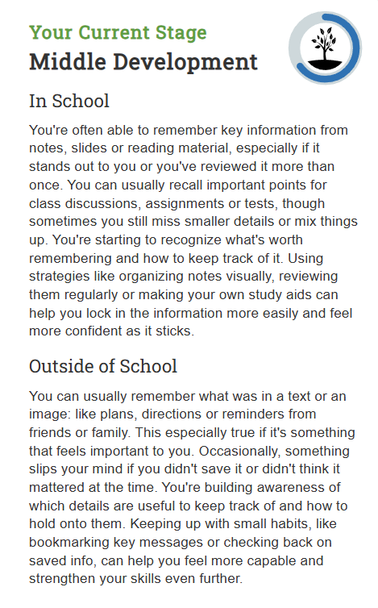
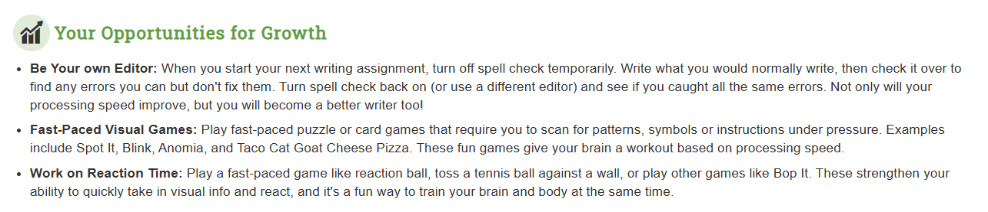
Parts of your report
Career paths that use this aptitude
Where you’re at today and what it means
Ways to keep building this aptitude
Notes:
See pages 7-9 of AchieveWorks Aptitudes Counselor Handbook for more detail

Slide 13
If you have questions
please contact your school counselor
Notes:
Please add your information to this last slide for student reference

